Slide 1
Artificial intelligence
Session – 6
Date – 29th May, 2022

Slide 2
OpenCV - Overview
OpenCV is a cross-platform library using which we can develop real-time computer vision applications. It mainly focuses on image processing, video capture and analysis including features like face detection and object detection.
Let’s start the chapter by defining the term "Computer Vision".
Computer Vision
Computer Vision can be defined as a discipline that explains how to reconstruct, interrupt, and understand a 3D scene from its 2D images, in terms of the properties of the structure present in the scene. It deals with modeling and replicating human vision using computer software and hardware.
Computer Vision overlaps significantly with the following fields −
Image Processing − It focuses on image manipulation.
Pattern Recognition − It explains various techniques to classify patterns.
Photogrammetry − It is concerned with obtaining accurate measurements from images.
Computer Vision Vs Image Processing
Image processing deals with image-to-image transformation. The input and output of image processing are both images.
Computer vision is the construction of explicit, meaningful descriptions of physical objects from their image. The output of computer vision is a description or an interpretation of structures in 3D scene.

Slide 3
OpenCV - Overview
OpenCV is an open-source library for the computer vision. It provides the facility to the machine to recognize the faces or objects. In this tutorial we will learn the concept of OpenCV using the Python programming language.
Our OpenCV tutorial includes all topics of Read and Save Image, Canny Edge Detection, Template matching, Blob Detection, Contour, Gaussian blur and so on.

Slide 4
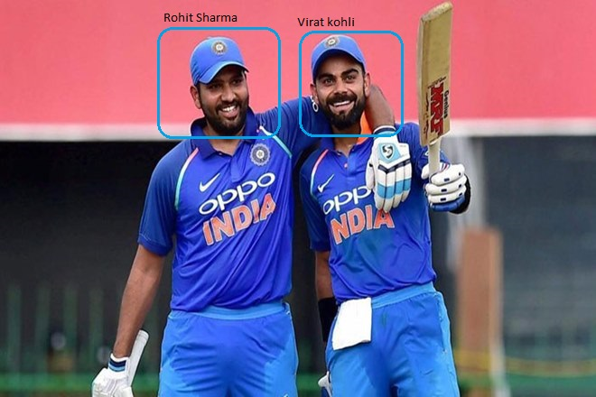
What is OpenCV?
OpenCV is a Python open-source library, which is used for computer vision in Artificial intelligence, Machine Learning, face recognition, etc.
In OpenCV, the CV is an abbreviation form of a computer vision, which is defined as a field of study that helps computers to understand the content of the digital images such as photographs and videos.
The purpose of computer vision is to understand the content of the images. It extracts the description from the pictures, which may be an object, a text description, and three-dimension model, and so on. For example, cars can be facilitated with computer vision, which will be able to identify and different objects around the road, such as traffic lights, pedestrians, traffic signs, and so on, and acts accordingly.
Computer vision allows the computer to perform the same kind of tasks as humans with the same efficiency. There are a two main task which are defined below:
Object Classification - In the object classification, we train a model on a dataset of particular objects, and the model classifies new objects as belonging to one or more of your training categories.
Object Identification - In the object identification, our model will identify a particular instance of an object - for example, parsing two faces in an image and tagging one as Virat Kohli and other one as Rohit Sharma.

Slide 5
History
OpenCV stands for Open Source Computer Vision Library, which is widely used for image recognition or identification. It was officially launched in 1999 by Intel. It was written in C/C++ in the early stage, but now it is commonly used in Python for the computer vision as well.
The first alpha version of OpenCV was released for the common use at the IEEE Conference on Computer Vision and Pattern Recognition in 2000, and between 2001 and 2005, five betas were released. The first 1.0 version was released in 2006.
The second version of the OpenCV was released in October 2009 with the significant changes. The second version contains a major change to the C++ interface, aiming at easier, more type-safe, pattern, and better implementations. Currently, the development is done by an independent Russian team and releases its newer version in every six months.

Slide 6
Applications of Computer Vision
Robotics Application
Localization − Determine robot location automatically
Navigation
Obstacles avoidance
Manipulation (e.g. PUMA robot manipulator)
Medicine Application
Classification and detection (e.g. lesion or cells classification and tumor detection)
2D/3D segmentation
3D human organ reconstruction (MRI or ultrasound)
Industrial Automation Application
Industrial inspection (defect detection)
Barcode and package label reading
Object sorting
Security Application
Biometrics (iris, finger print, face recognition)
Surveillance − Detecting certain suspicious activities or behaviors
Transportation Application
Autonomous vehicle
Safety, e.g., driver vigilance monitoring

Slide 7
Features of OpenCV Library
Using OpenCV library, you can −
Read and write images
Capture and save videos
Process images (filter, transform)
Perform feature detection
Detect specific objects such as faces, eyes, cars, in the videos or images.
Analyze the video, i.e., estimate the motion in it, subtract the background, and track objects in it.
OpenCV was originally developed in C++. In addition to it, Python and Java bindings were provided. OpenCV runs on various Operating Systems such as windows, Linux, OSx, FreeBSD, Net BSD, Open BSD, etc.

Slide 8
How OpenCV Works?

Slide 9
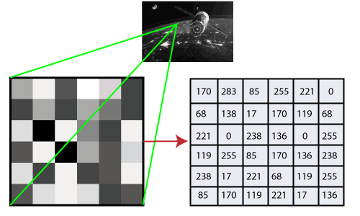
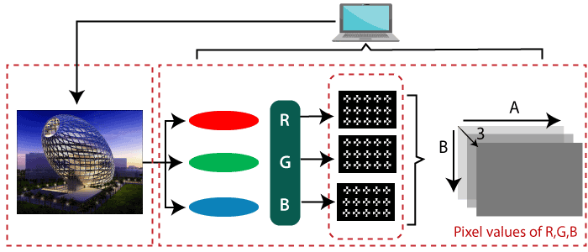
How does computer recognize the image?
Human eyes provide lots of information based on what they see. Machines are facilitated with seeing everything, convert the vision into numbers and store in the memory. Here the question arises how computer convert images into numbers. So the answer is that the pixel value is used to convert images into numbers. A pixel is the smallest unit of a digital image or graphics that can be displayed and represented on a digital display device. The picture intensity at the particular location is represented by the numbers. In the above image, we have shown the pixel values for a grayscale image consist of only one value, the intensity of the black color at that location.
There are two common ways to identify the images:
1. Grayscale
Grayscale images are those images which contain only two colors black and white. The contrast measurement of intensity is black treated as the weakest intensity, and white as the strongest intensity. When we use the grayscale image, the computer assigns each pixel value based on its level of darkness.
2. RGB
An RGB is a combination of the red, green, blue color which together makes a new color. The computer retrieves that value from each pixel and puts the results in an array to be interpreted.

Slide 10
Why OpenCV is used for Computer Vision?
OpenCV is available for free of cost.
Since the OpenCV library is written in C/C++, so it is quit fast. Now it can be used with Python.
It require less RAM to usage, it maybe of 60-70 MB.
Computer Vision is portable as OpenCV and can run on any device that can run on C.

Slide 11
Install OpenCV in the Windows via pip
OpenCV is a Python library so it is necessary to install Python in the system and install OpenCV using pip command:
Update pip – pip install –upgrade pip
Install opencv in C drive
pip install opencv-python

Slide 12
OpenCV Read and Save Image

Slide 13
OpenCV Reading Images
OpenCV allows us to perform multiple operations on the image, but to do that it is necessary to read an image file as input, and then we can perform the various operations on it. OpenCV provides following functions which are used to read and write the images.

Slide 14
OpenCV imread function
The imread() function loads image from the specified file and returns it. The syntax is:
cv2.imread(filename[,flag])
Parameters:
filename: Name of the file to be loaded
flag: The flag specifies the color type of a loaded image:
CV_LOAD_IMAGE_ANYDEPTH - If we set it as flag, it will return 16-bits/32-bits image when the input has the corresponding depth, otherwise convert it to 8-BIT.
CV_LOAD_IMAGE_COLOR - If we set it as flag, it always return the converted image to the color one.
C V_LOAD_IMAGE_GRAYSCALE - If we set it as flag, it always convert image into the grayscale.
The imread() function returns a matrix, if the image cannot be read because of unsupported file format, missing file, unsupported or invalid format. Currently, the following file formats are supported.
Window bitmaps - *.bmp, *.dib JPEG files - *.jpeg, *.jpg, *.jpe Portable Network Graphics - *.png Portable image format- *.pbm, *.pgm, *.ppm TIFF files - *.tiff, *.tif

Slide 15
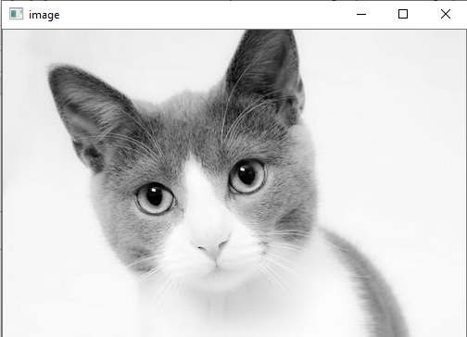
Example
#importing the opencv module
import cv2
# using imread('path') and 0 denotes read as grayscale image
img = cv2.imread(r’path\cat.jpeg',1)
#This is using for display the image
cv2.imshow('image',img)
cv2.waitKey(3) # This is necessary to be required so that the image doesn't close immediately.
#It will run continuously until the key press.
cv2.destroyAllWindows()

Slide 16
OpenCV Save Images
OpenCV imwrite() function is used to save an image to a specified file. The file extension defines the image format. The syntax is the following:
cv2.imwrite(filename, img[,params])
Parameters:
filename- Name of the file to be loaded
image- Image to be saved.
params- The following parameters are currently supported:
For JPEG, quality can be from 0 to 100. The default value is 95.
For PNG, quality can be the compress level from 0 to 9. The default value is 1.
For PPM, PGM, or PBM, it can be a binary format flag 0 or 1. The default value is 1.
import cv2
# read image as grey scale
img = cv2.imread(r’path\cat.jpeg', 1)
# save image
status = cv2.imwrite(r’path\cat.jpeg', 0, img)
print("Image written to file-system : ", status)

Slide 17
OpenCV Basic Operation on Images
In this tutorial, we will learn the essential operations that are related to the images. We are going to discuss the following topics.
Access pixel values and modify them
Access Image Properties
Setting Region of Image
Splitting and merging images
Change the image color

Slide 18
Accessing and Modifying pixel values
We can retrieve a pixel value by its row and column coordinates. It returns an array of blue, green, red values of the BGR image. It returns the corresponding intensity for the grayscale image. First, we need to load the BGR image.
import numpy as np
import cv2
img = cv2.imread(“path\cat.jpeg",1)
pixel = img[100,100]
print(pixel)

Slide 19
Accessing Image Properties
It is better to know the size of the image to work with the image processing application. In OpenCV, images are generally stored in the Numpy ndarray. To get the image shape or size, use ndarray.shape to find the dimension of the image. Then, we can use the index position to get the height, width, and number of channels.
Consider the following example:
import cv2
# read image
img = cv2.imread(r’path\cat.jpeg',1)
# height, width, number of channels in image
height = img.shape[0]
width = img.shape[1]
channels = img.shape[2]
size1 = img.size
print('Image Dimension : ',dimensions)
print('Image Height : ',height)
print('Image Width : ',width)
print('Number of Channels : ',channels)
print('Image Size :', size1)

Slide 20
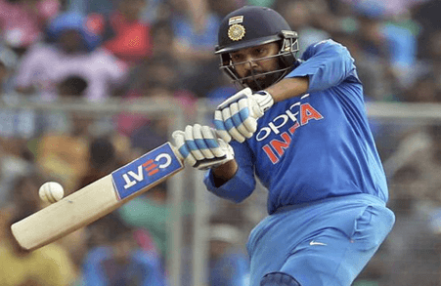
Image ROI (Region of Interest)
Sometimes, we need to work with some areas of the image. As we discuss in the previous tutorial face detection is over the entire picture. When a face is obtained, we select only the face region and search for eyes inside it instead of searching the whole image. It enhances accuracy and performance because eyes are always on the face and don't need to search the entire image.
In the above image, if we need to select the ball. We only require selecting the ball region.

Slide 21
Splitting and Merging Image channels
An image's BGR channels can be split into their planes when needed. Then, the individual channels can be merged back together from the BGR image again. This can be done by following way:
b,g,r = cv2.split(img)
img = cv2.merge((b,g,r))
Or
b = img[:,:,0]

Slide 22
Making Borders for Images
OpenCV provides the cv2.copyMakeBorder() function to create a border around the image, something like a photo frame. The syntax of the function is given below.
cv2.copyMakeBorder(src,top,bottom,left,right,border type)
Parameters:
src - It denotes input image.
top, bottom, left, right - It defines the border width in the number of pixels in the corresponding direction.
borderType - It defines what kind of border to be added. The border can be the following types.
value - Color of border if border type is cv.BORDER_CONSTANT

Slide 23
Making Borders for Images
Consider the following example:
import cv2 as cv
import numpy as np
from matplotlib import pyplot as plt
BLUE = [255,0,0]
img1 = cv.imread(r’path\flower.jpg',1)
replicate = cv.copyMakeBorder(img1,10,10,10,10,cv.BORDER_REPLICATE)
reflect = cv.copyMakeBorder(img1,10,10,10,10,cv.BORDER_REFLECT)
reflect101 = cv.copyMakeBorder(img1,10,10,10,10,cv.BORDER_REFLECT_101)
wrap = cv.copyMakeBorder(img1,10,10,10,10,cv.BORDER_WRAP)
constant= cv.copyMakeBorder(img1,10,10,10,10,cv.BORDER_CONSTANT,value=BLUE)
plt.subplot(231),plt.imshow(img1,'gray'),plt.title('ORIGINAL')
plt.subplot(232),plt.imshow(replicate,'gray'),plt.title('REPLICATE')
plt.subplot(233),plt.imshow(reflect,'gray'),plt.title('REFLECT')
plt.subplot(234),plt.imshow(reflect101,'gray'),plt.title('REFLECT_101')
plt.subplot(235),plt.imshow(wrap,'gray'),plt.title('WRAP')
plt.subplot(236),plt.imshow(constant,'gray'),plt.title('CONSTANT')
plt.show()

Slide 24
Change in Image color
OpenCV cvtColor
The cvtColor is used to convert an image from one color space to another. The syntax is following:
cv2.cvtColor(src, dst, code)
Parameters:
src - It is used to input an image: 8-bit unsigned.
dst - It is used to display an image as output. The output image will be same size and depth as input image.
code - color space conversion code.

Slide 25
Change in Image color
Consider the following example:
# importing cv2
import cv2
# path of the input image
path = (r’path\cat.jpeg')
# Reading an image in default mode
src = cv2.imread(path)
# Window name in which image is displayed
window_name = 'Image'
# Using cv2.cvtColor() method
# Using cv2.COLOR_BGR2GRAY color space for convert BGR image to grayscale
# conversion code
image = cv2.cvtColor(src, cv2.COLOR_BGR2GRAY )
# Displaying the image
cv2.imshow(window_name, image)

Slide 26
OpenCV Resize the image
Sometimes, it is necessary to transform the loaded image. In the image processing, we need to resize the image to perform the particular operation. Images are generally stored in Numpy ndarray(array). The ndarray.shape is used to obtain the dimension of the image. We can get the width, height, and numbers of the channels for each pixel by using the index of the dimension variable.
The resizing of image means changing the dimension of the image, its width or height as well as both. Also the aspect ratio of the original image could be retained by resizing an image. OpenCV provides cv2.resize() function to resize the image. The syntax is given as:
cv2.resize(src, dsize[, dst[, fx[,fy[,interpolation]]])
Parameters:
src - source/input image (required).
dsize - desired size for the output image(required)
fx - Scale factor along the horizontal axis.(optional)
fy - Scale factor along the vertical axis.
Interpolation(optional) - This flag uses following methods:
INTER_NEAREST - A nearest-interpolation
INTER_AREA - resampling using pixel area relation. When we attempt to do image zoom, it is similar to the INTER_NEAREST method.
INTER_CUBIC - A bicubic interpolation over 4×4 pixel neighborhood.
INTER_LANCOZS4 - Lanczos interpolation over 8×8 pixel neighborhood.

Slide 27
OpenCV Resize the image
Example
import cv2
img = cv2.imread(r’path\cat.jpeg', 1)
scale = 60
width = int(img.shape[1] * scale / 100)
height = int(img.shape[0] * scale / 100)
dim = (width, height)
# resize image
resized = cv2.resize(img, dim, interpolation=cv2.INTER_AREA)
print('Resized Dimensions : ', resized.shape)
cv2.imshow("Resized image", resized)
cv2.waitKey(0)
cv2.destroyAllWindows()

Slide 28
Example of resizing the images
There are several ways to resize the image. Below are some examples to perform resize operation:
Retain Aspect Ratio ( height to width ratio of the image is retained)
Downscale(Decrement in the size of the image)
Upscale(Increment in the size of image)
Do not preserve Aspect Ratio
Resize only the width
Resize only the height
Resize the specified width and height

